Slide 1
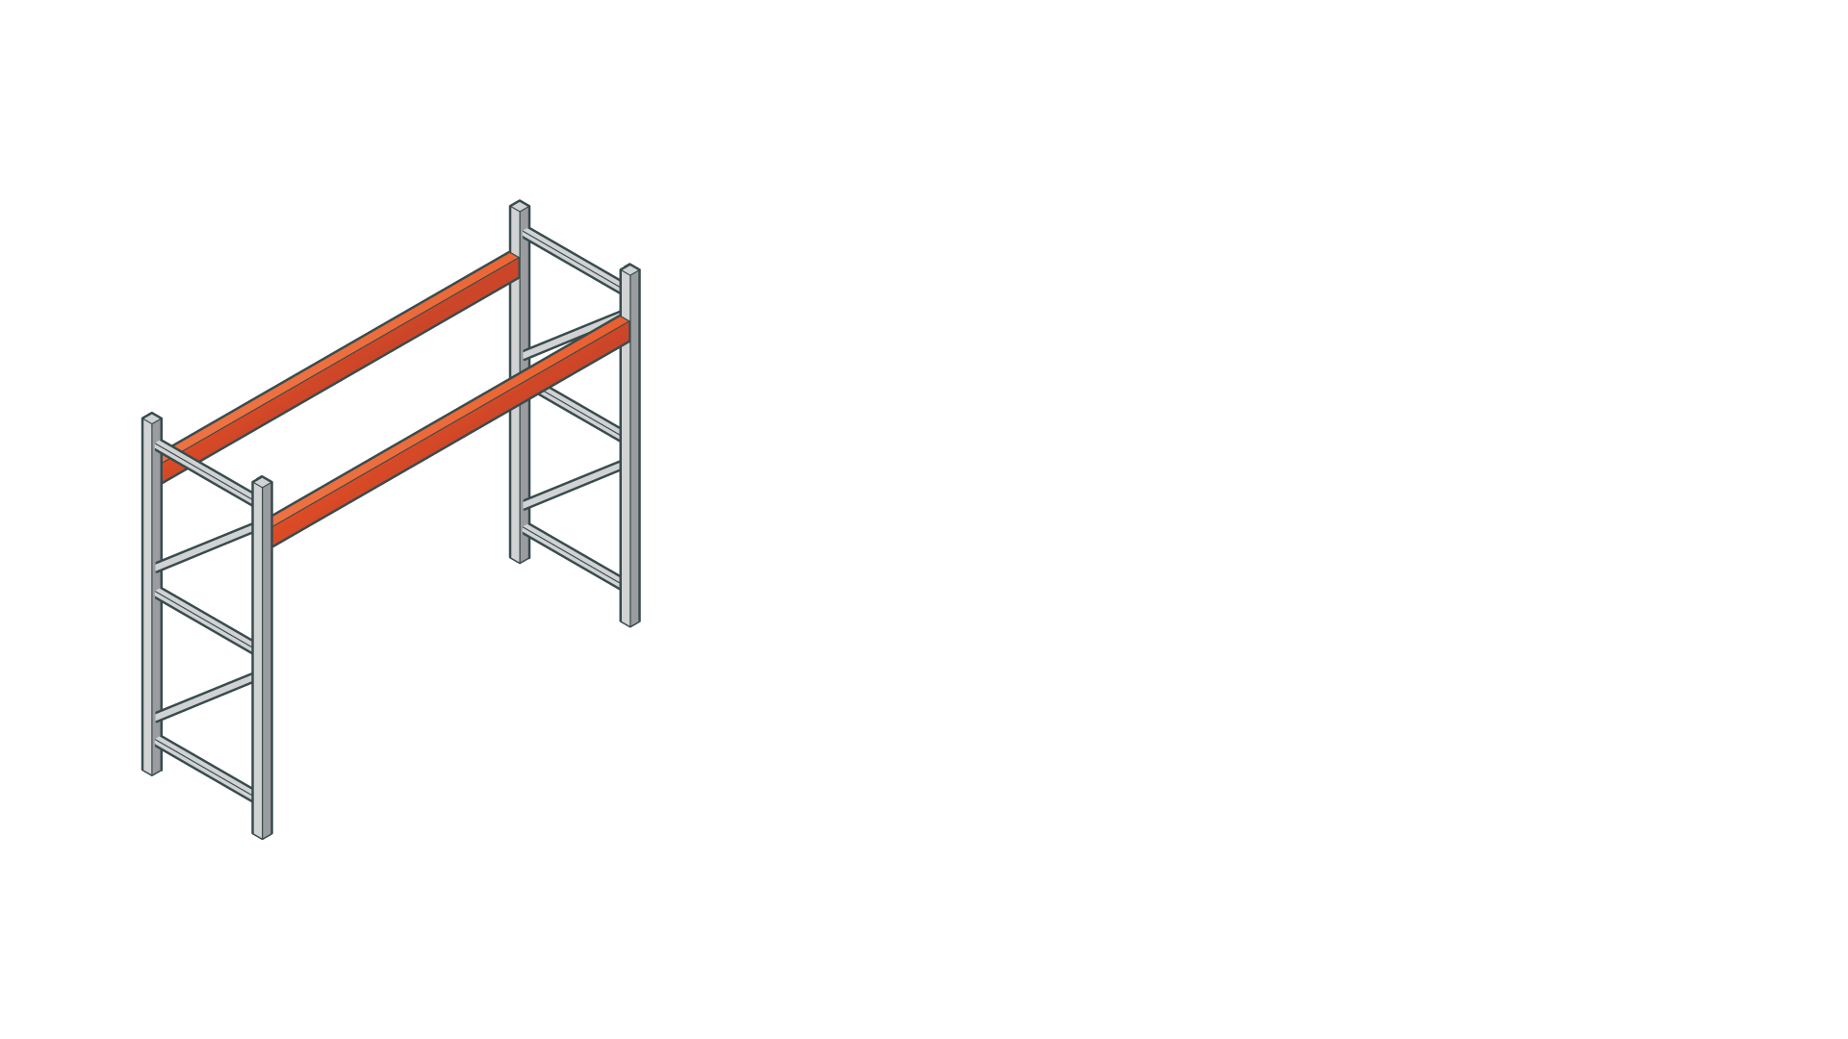
How do you maximize the ROI of your rack space?

Slide 2

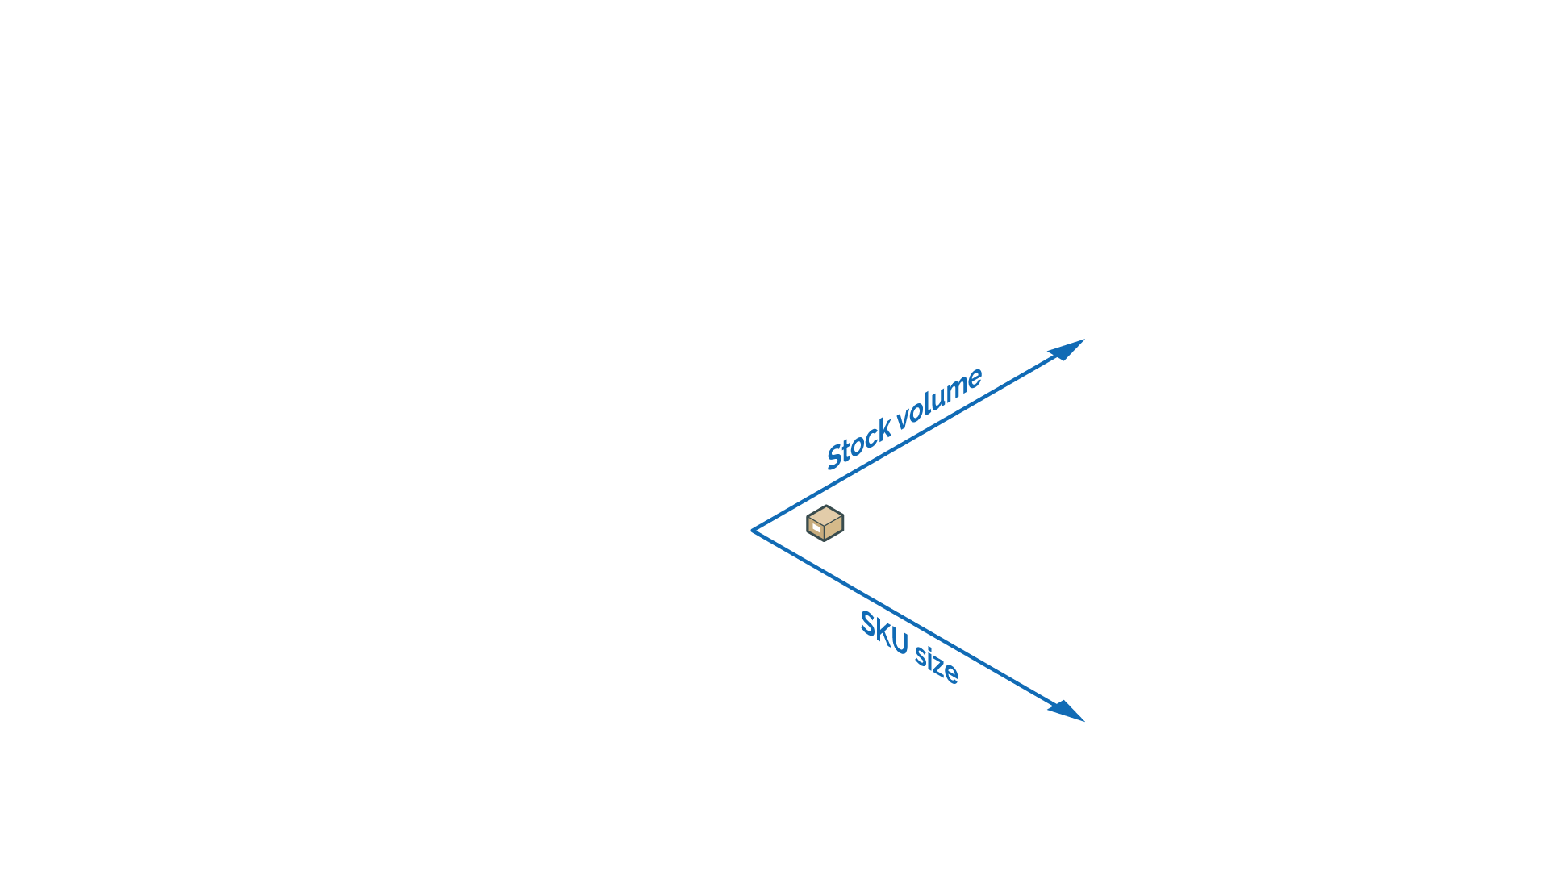

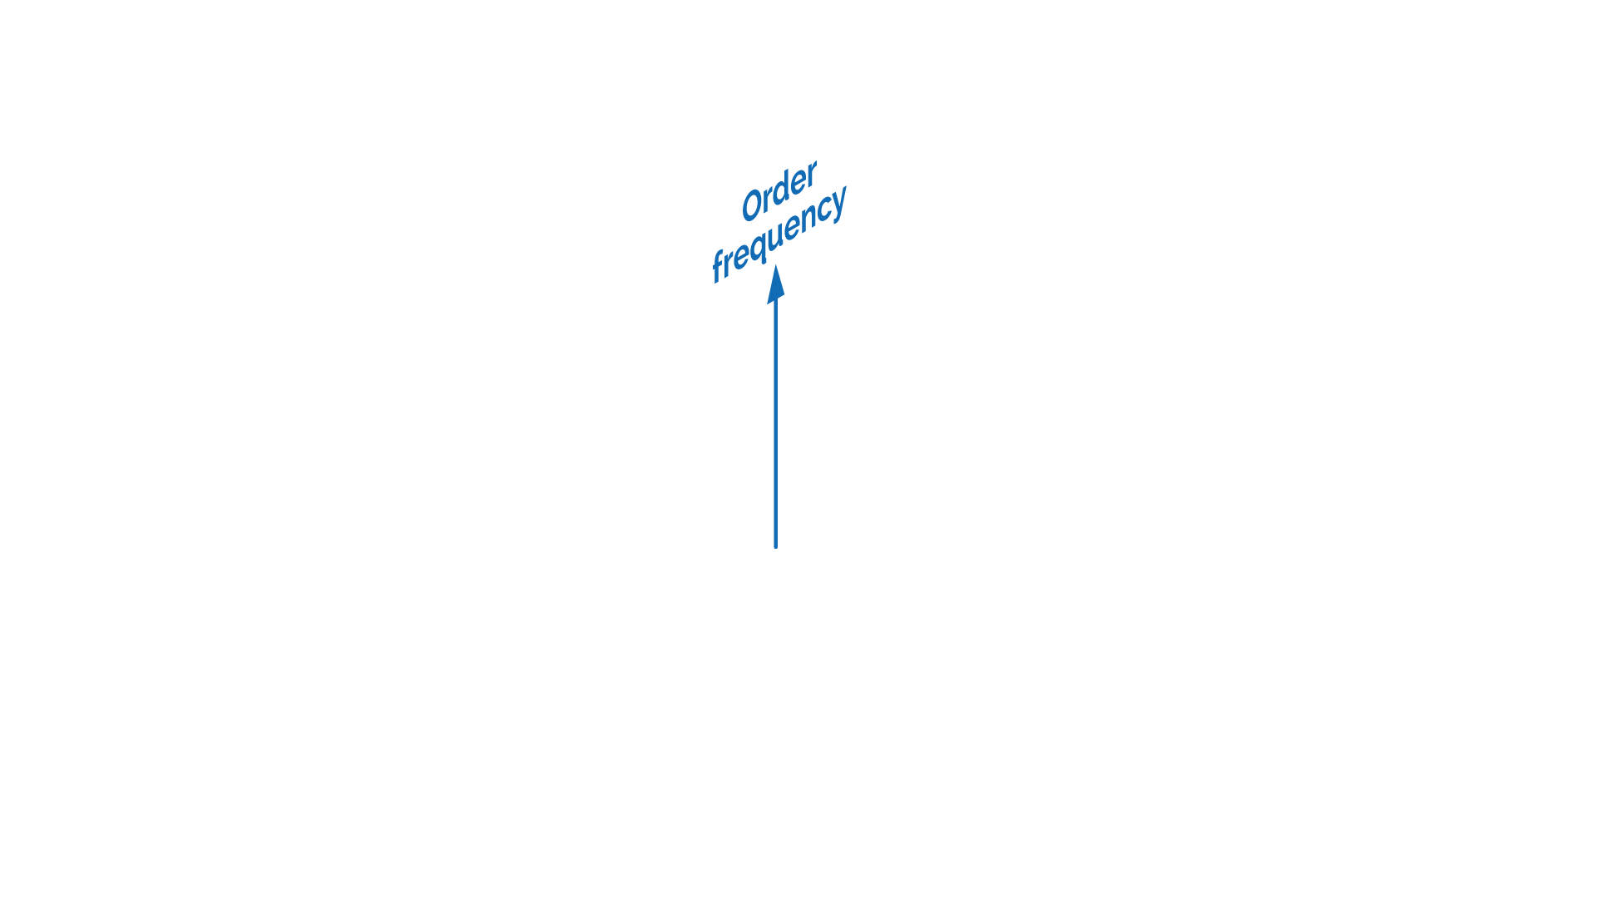
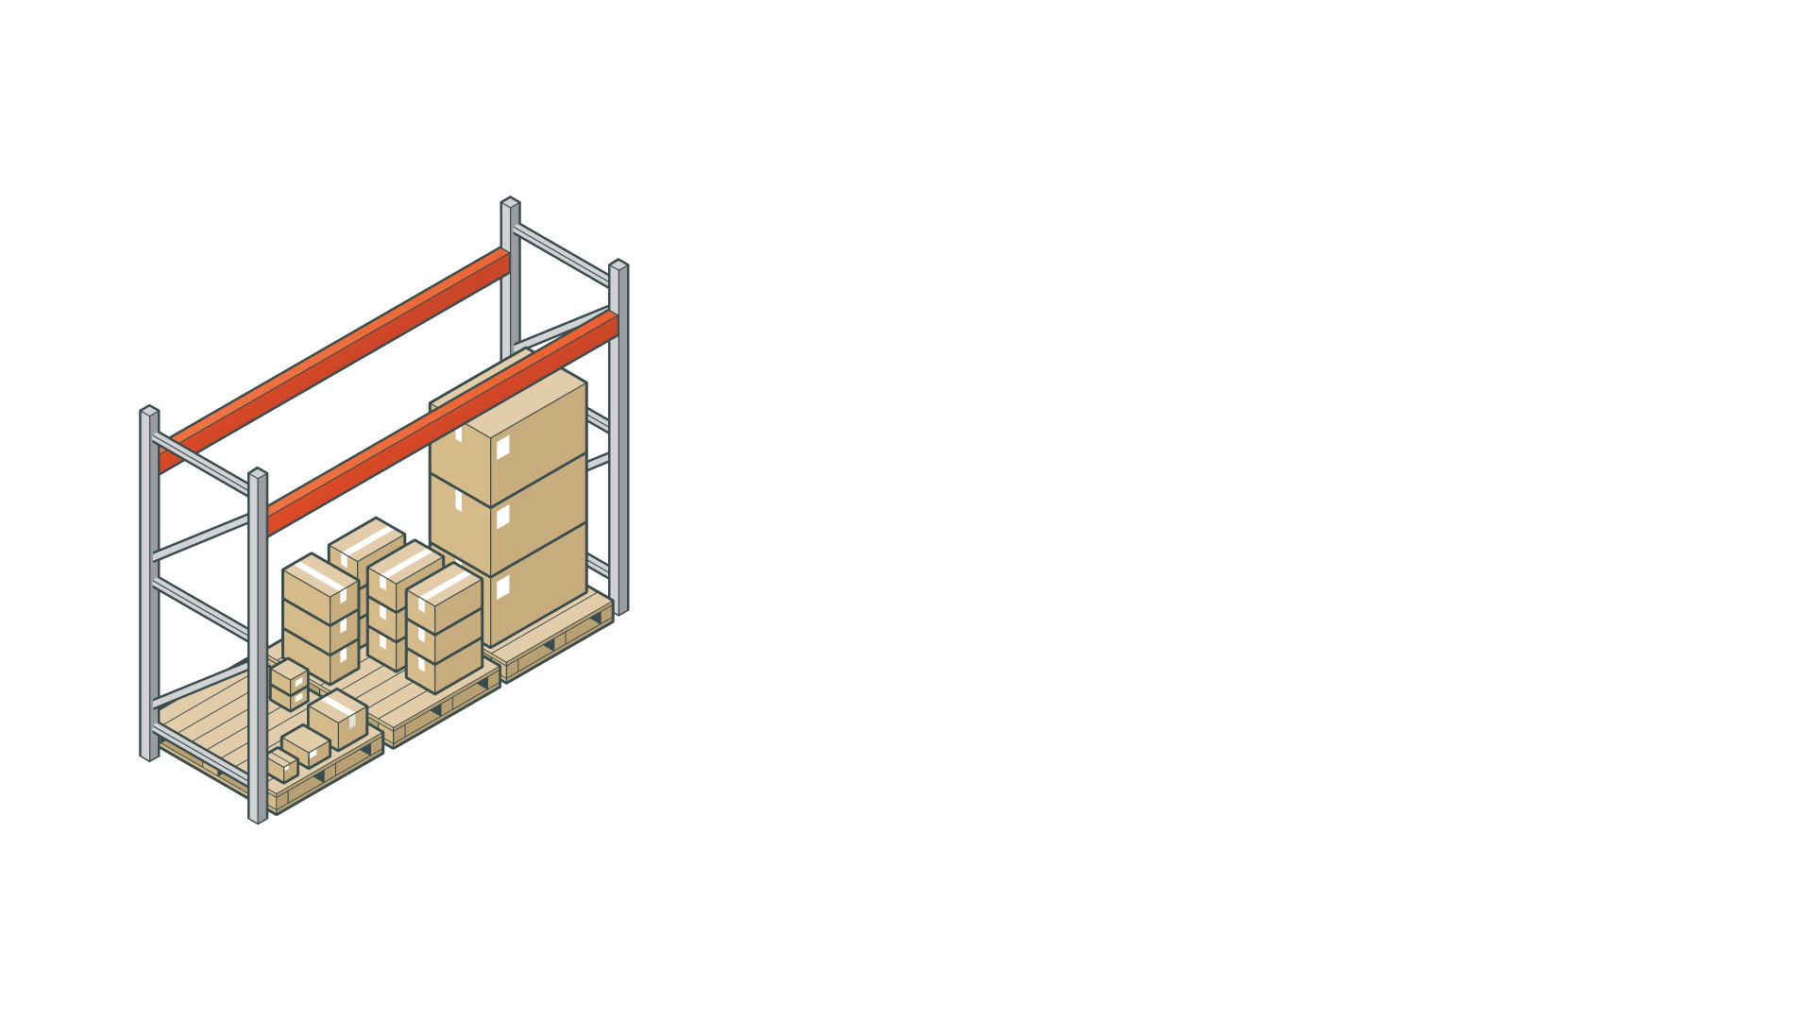

Slide 3

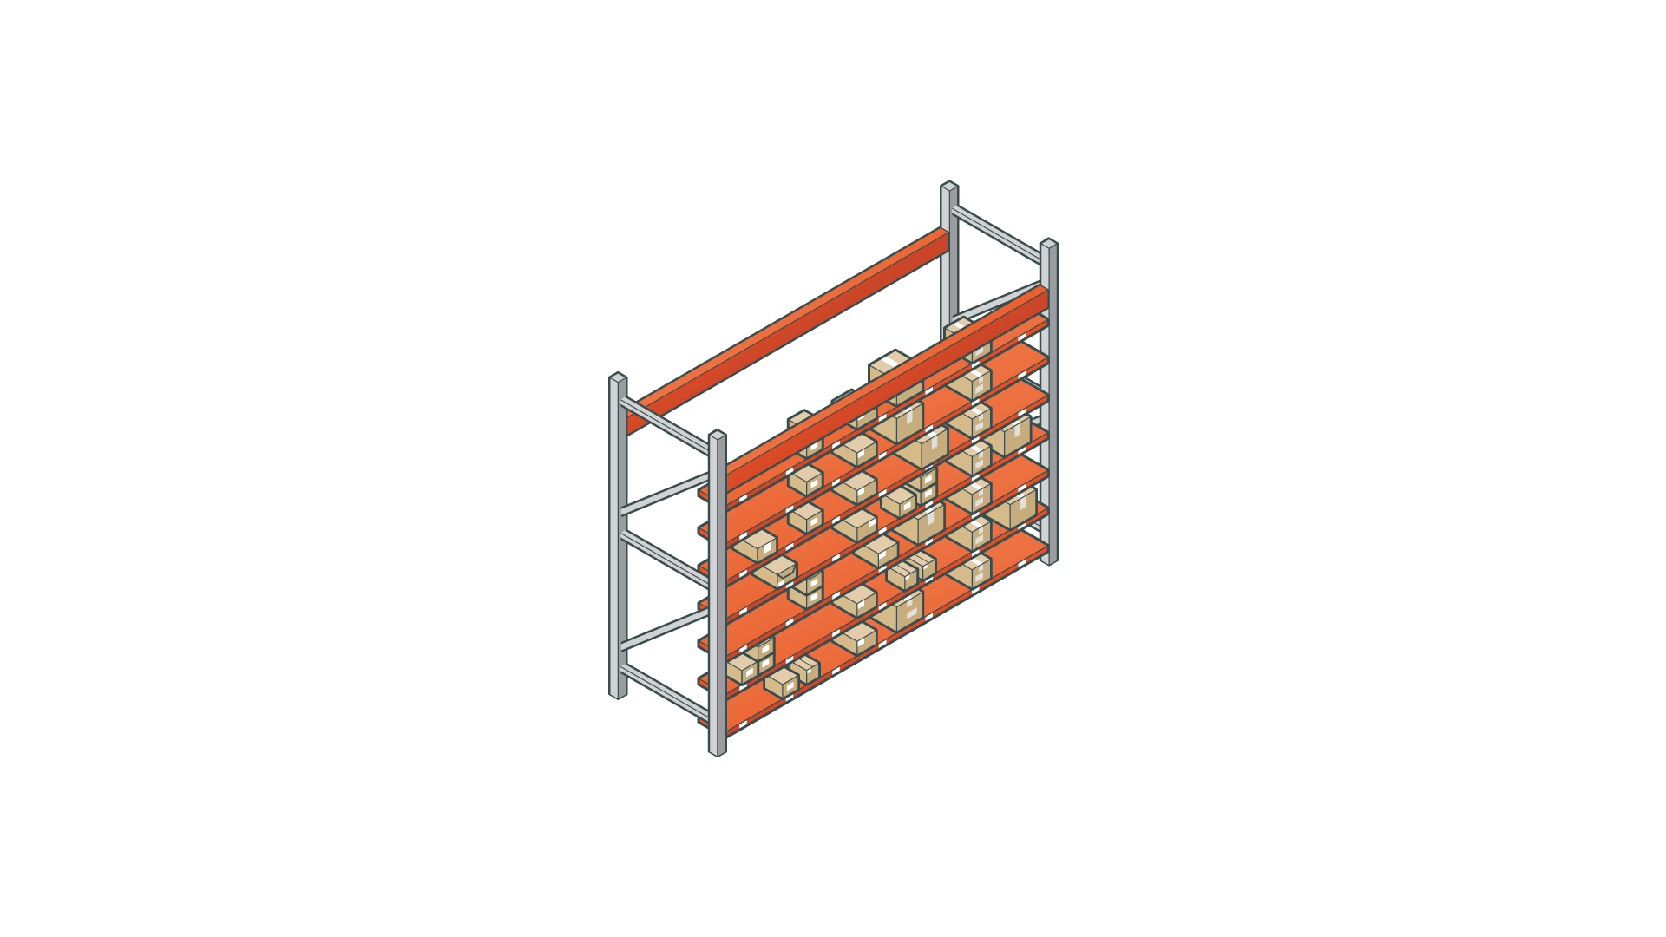
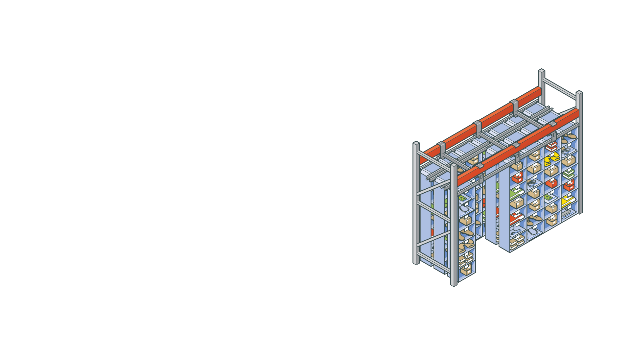

Slide 4
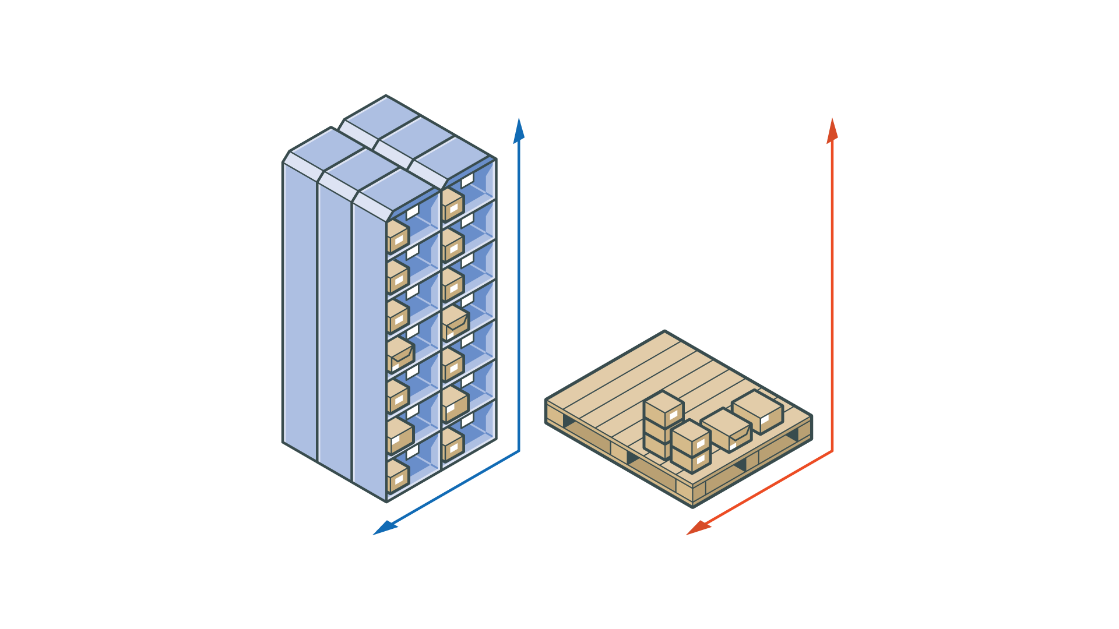
42 locations
3 locations

Slide 5
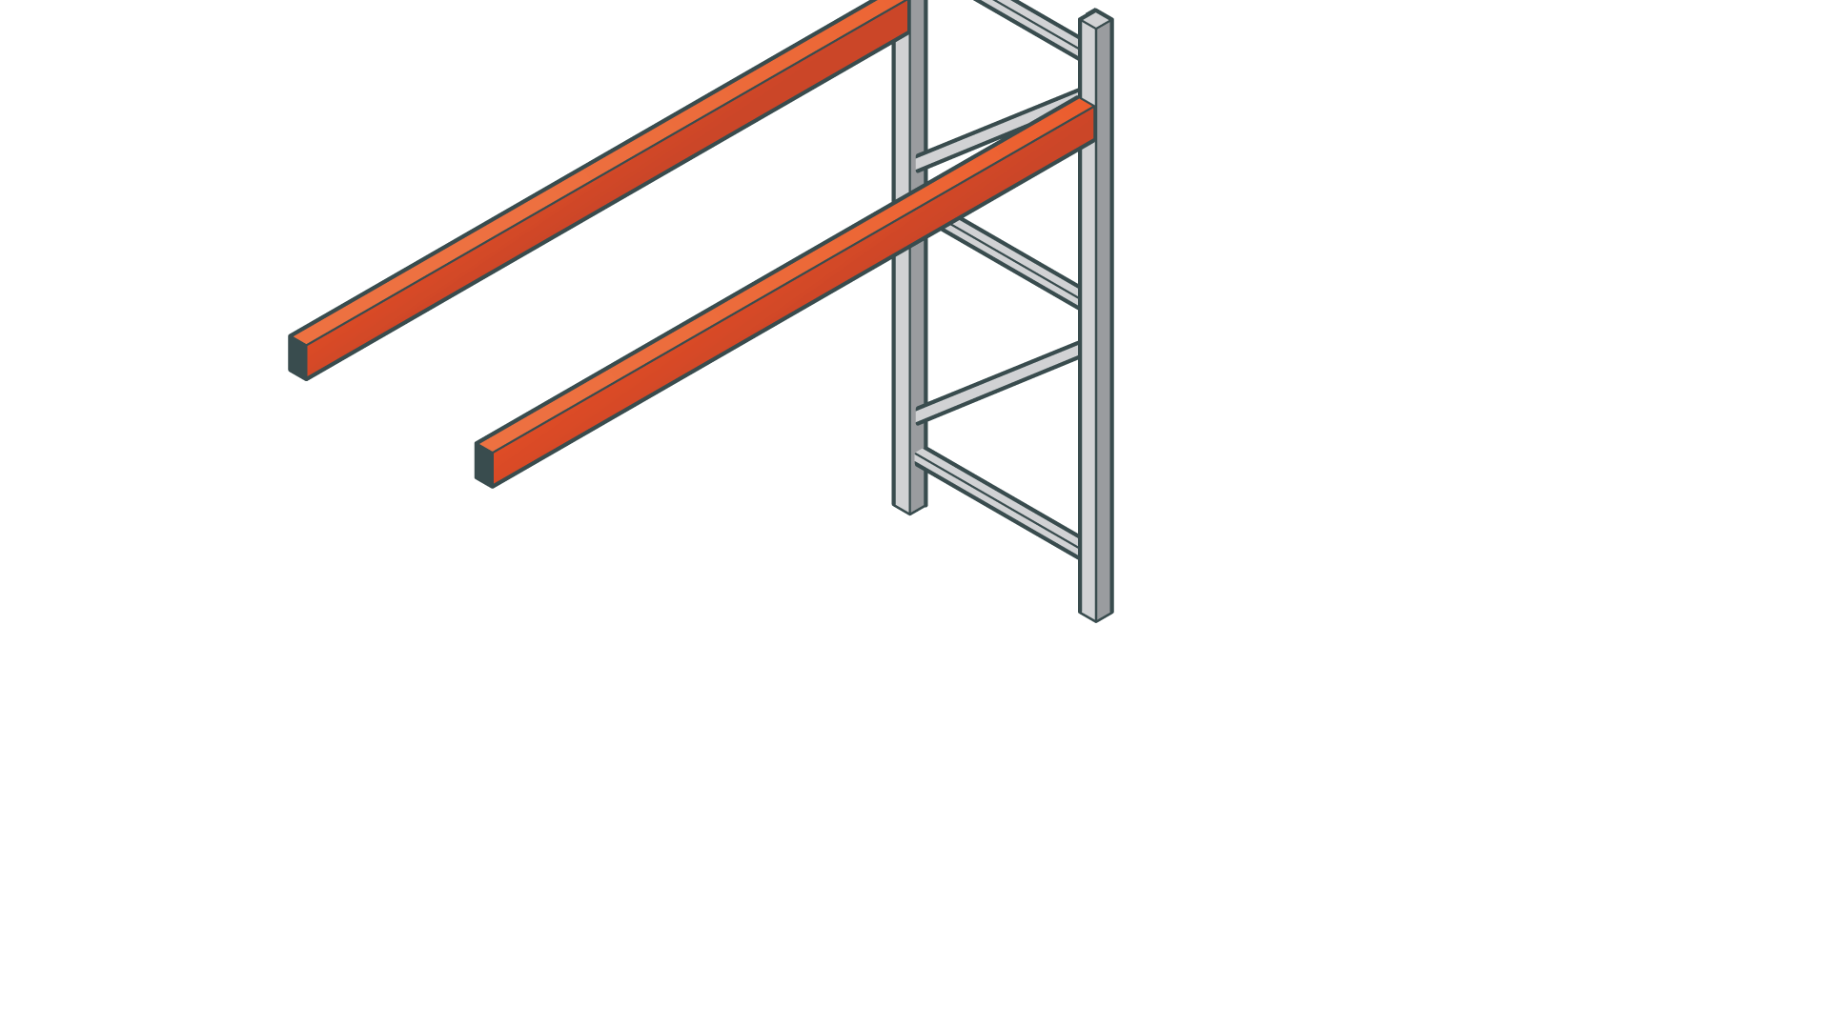
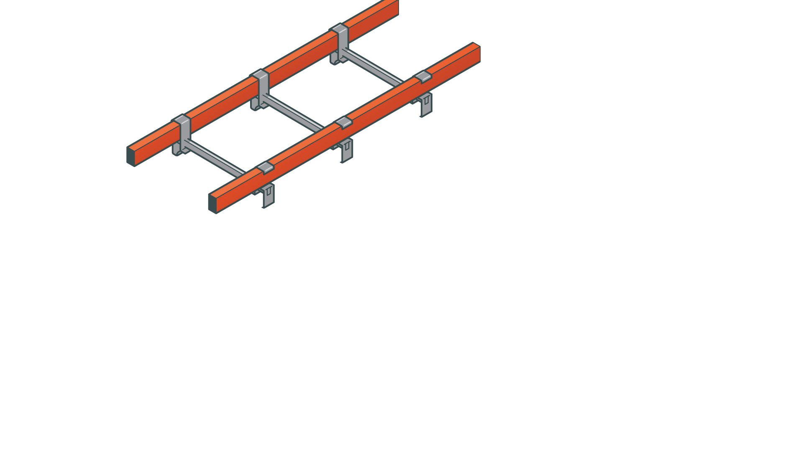
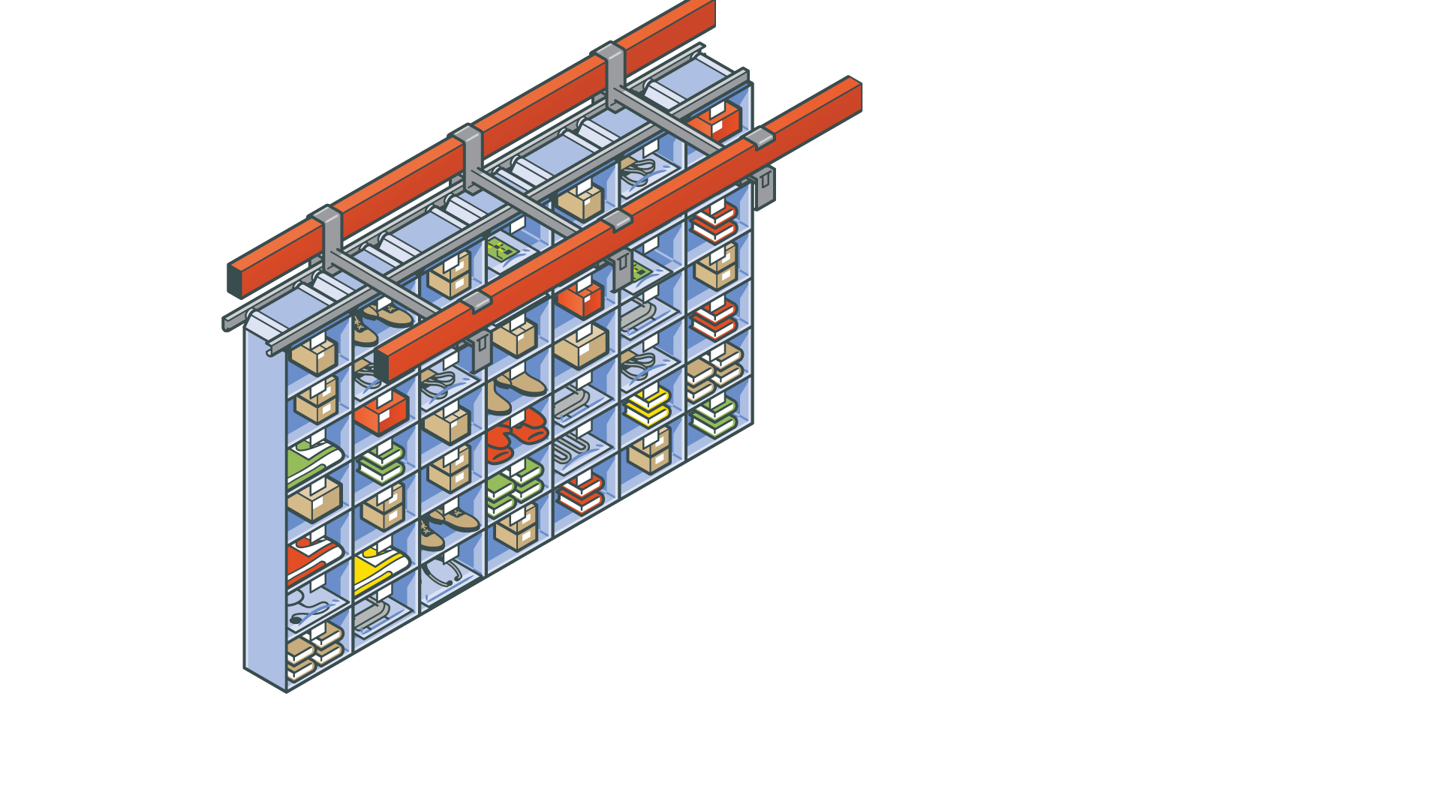
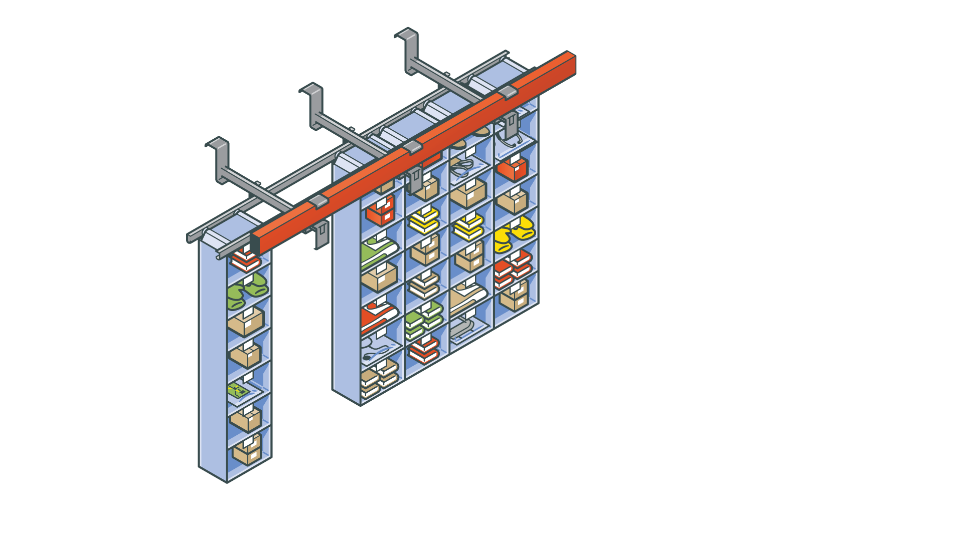
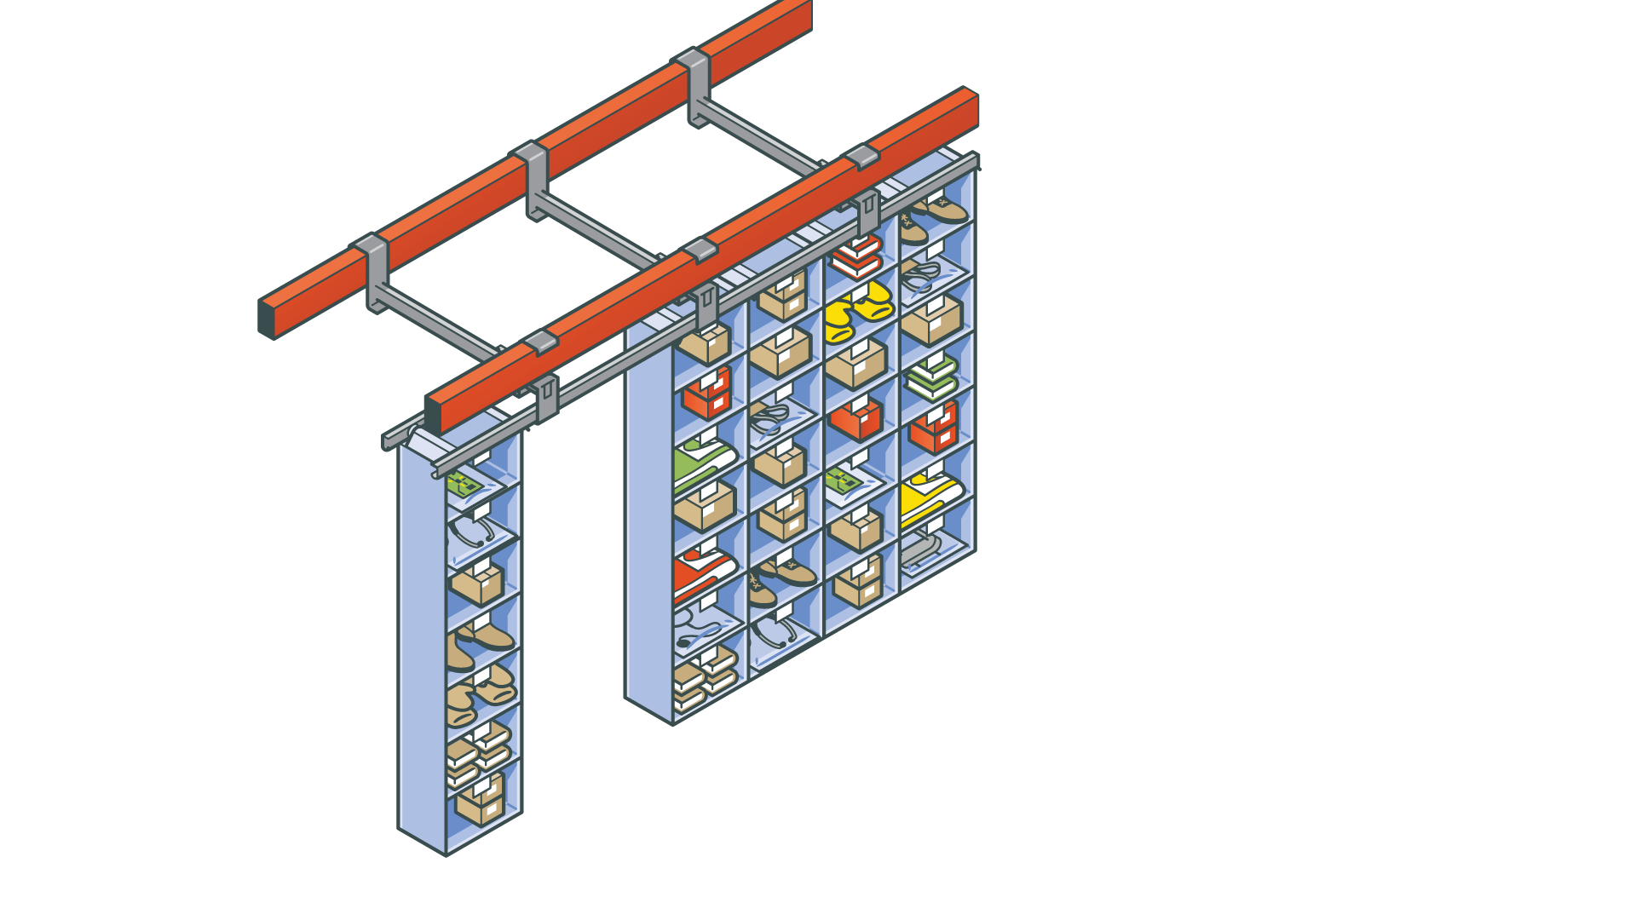
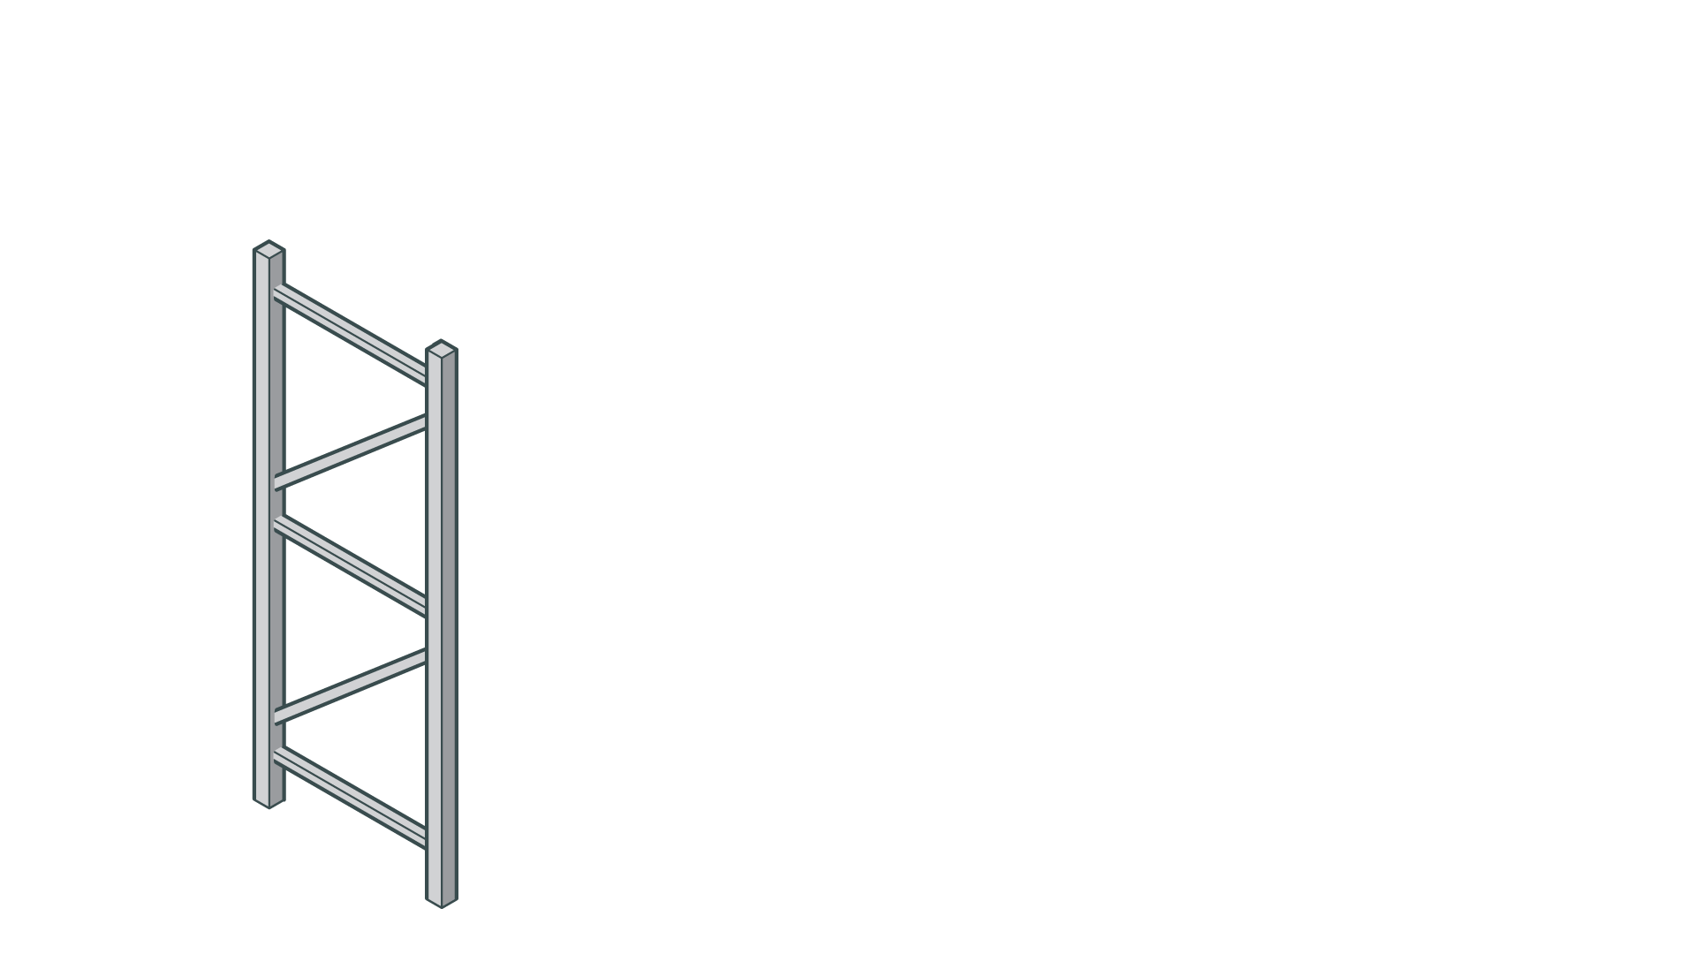



Slide 6
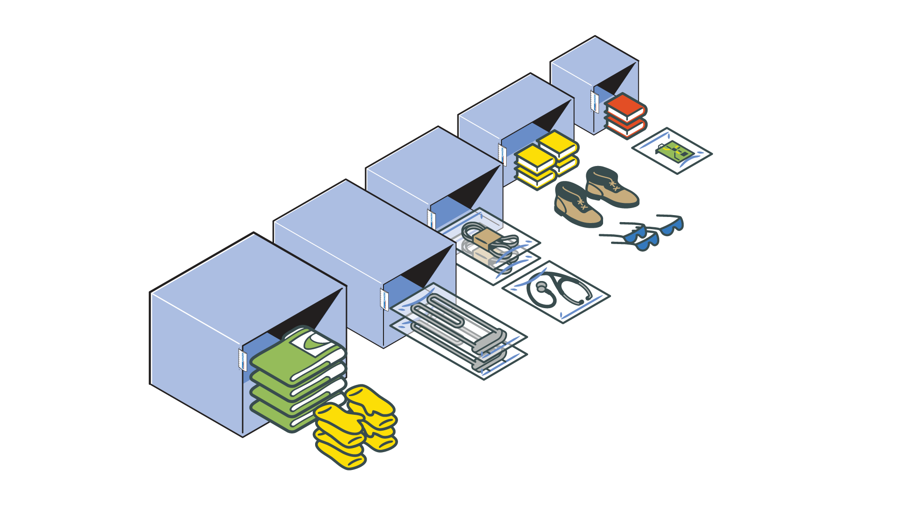

Slide 7

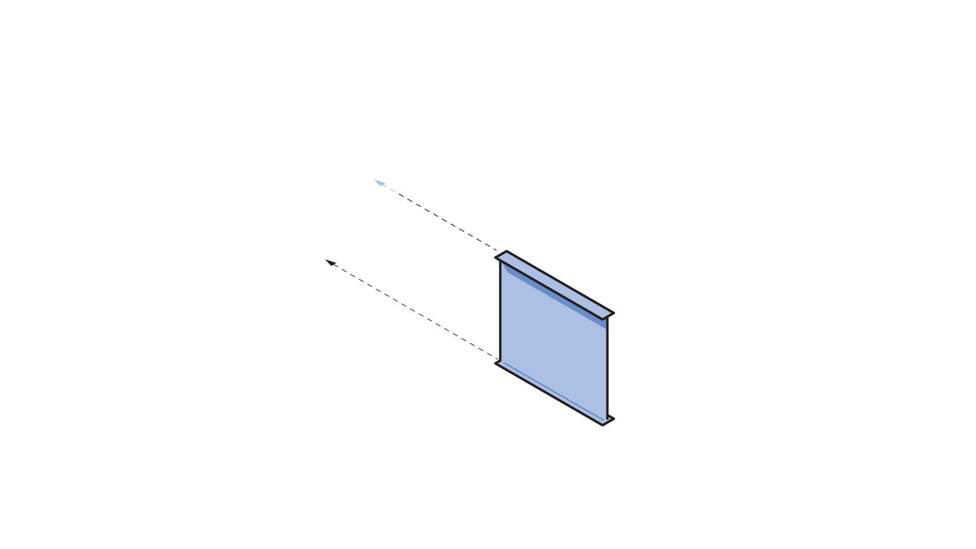
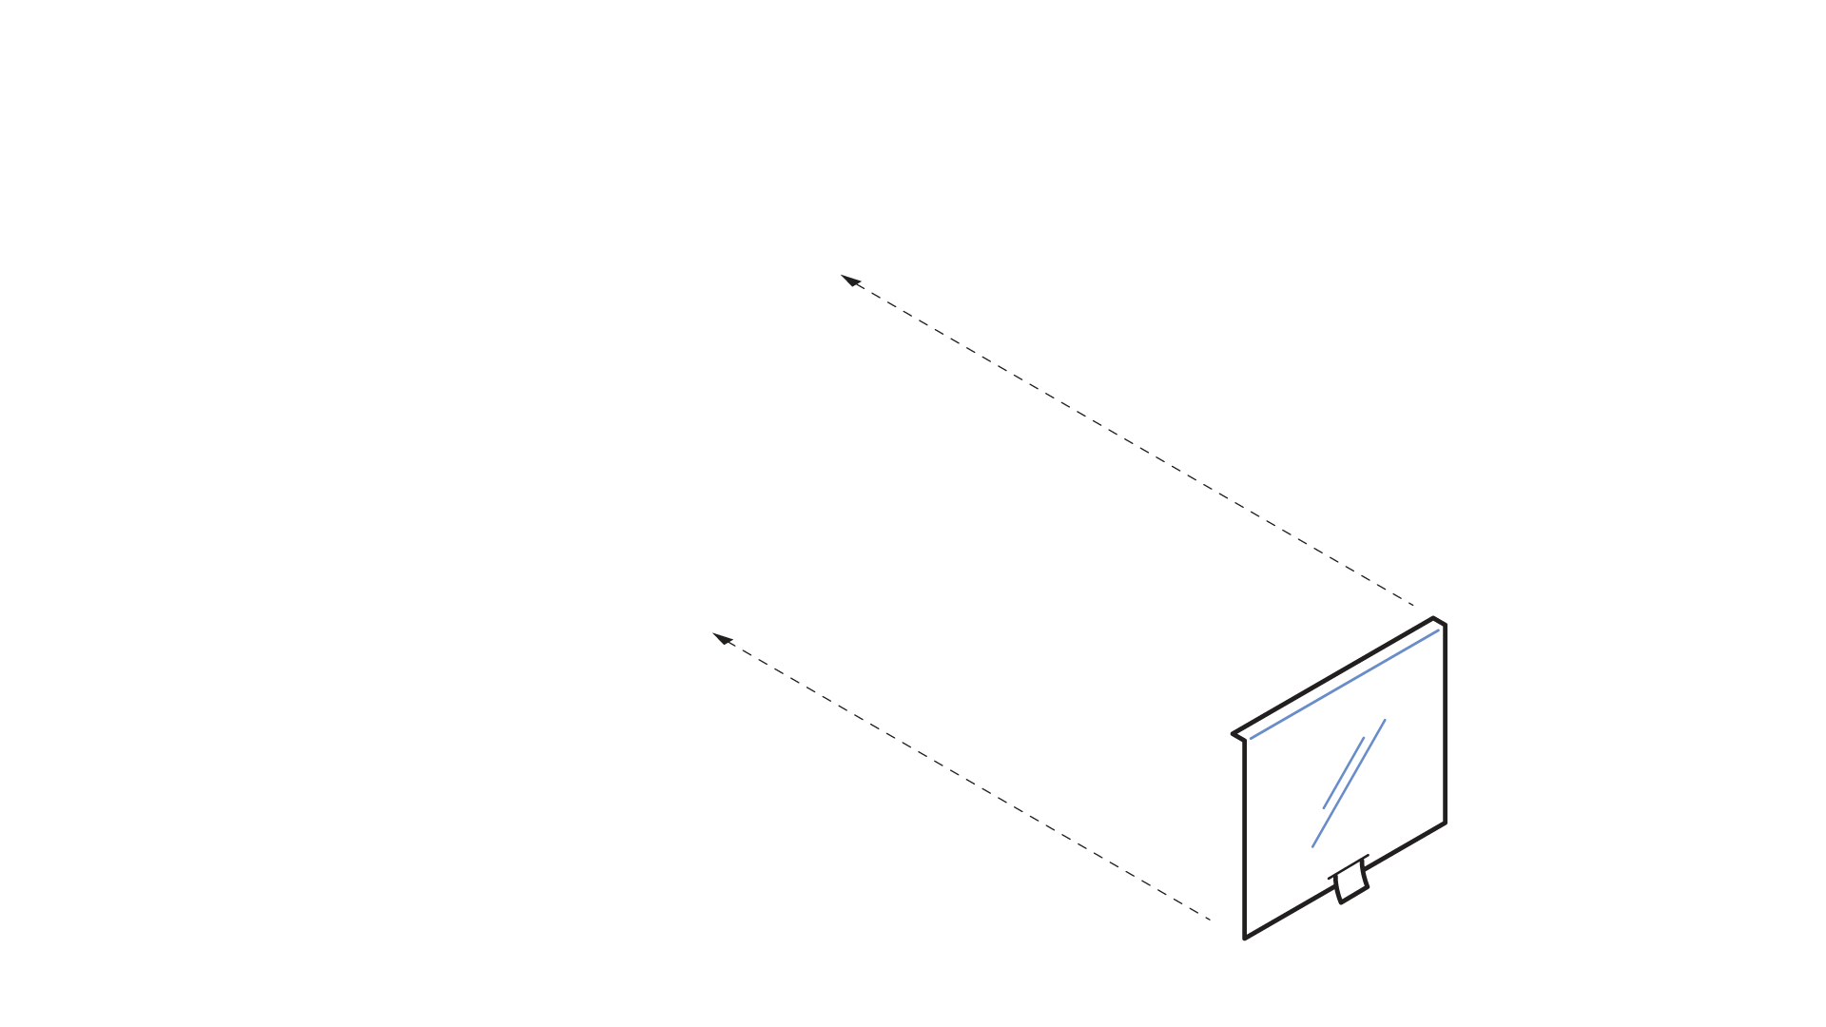
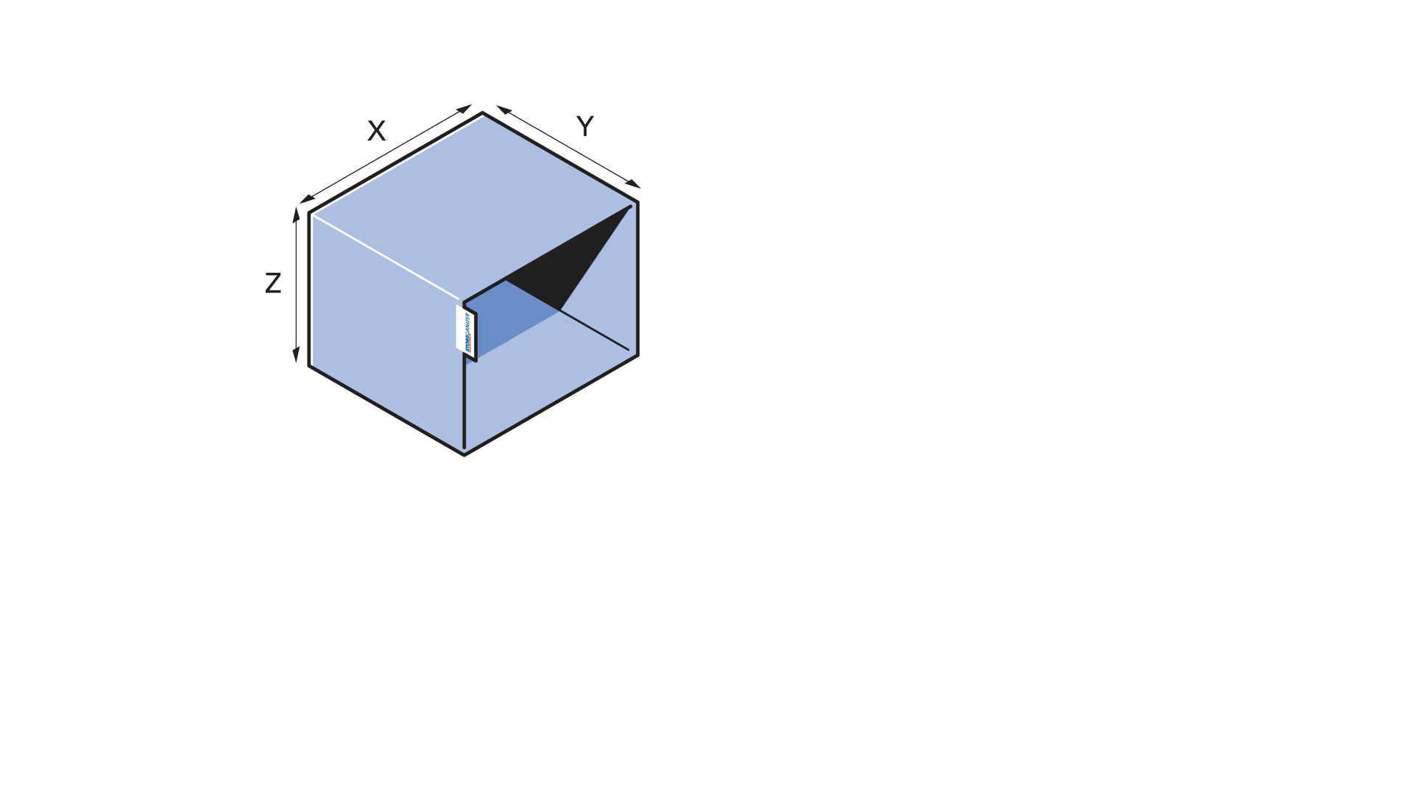

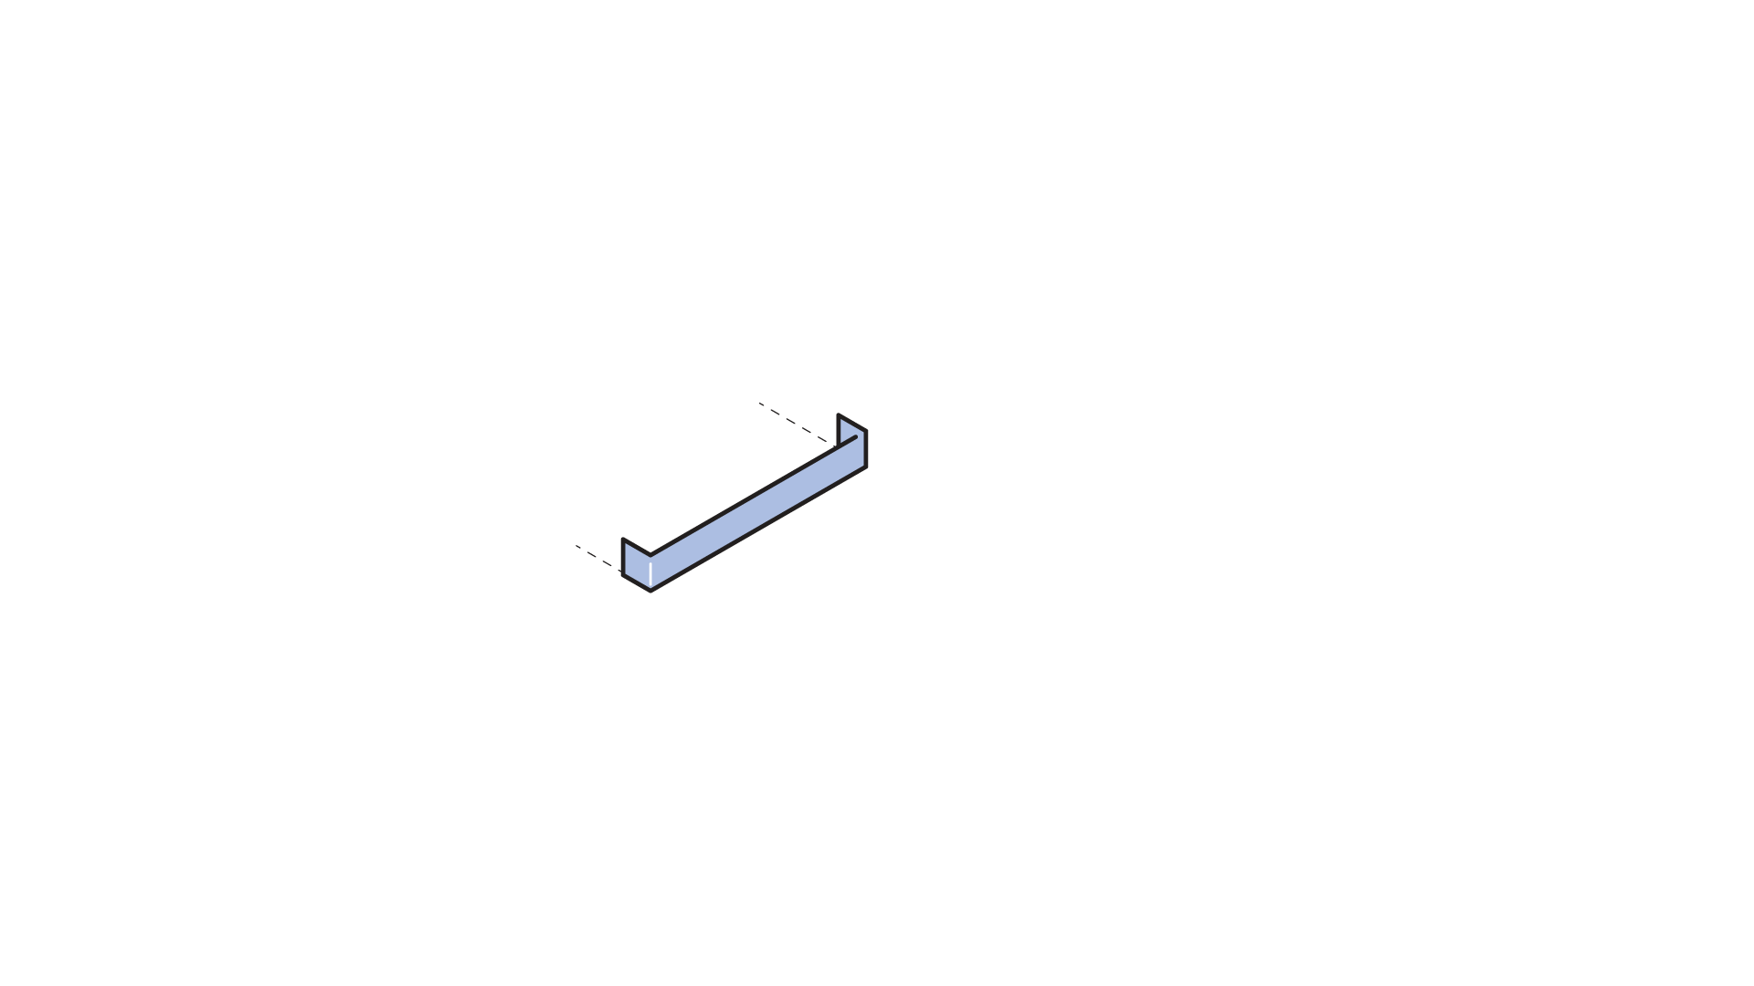
Notes:
Open sizes and specifications
Not limited to pre-set standard ranges.

Slide 8
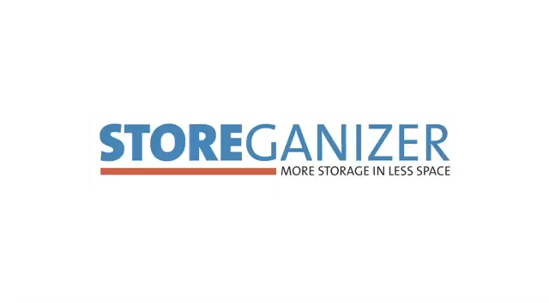

Slide 9

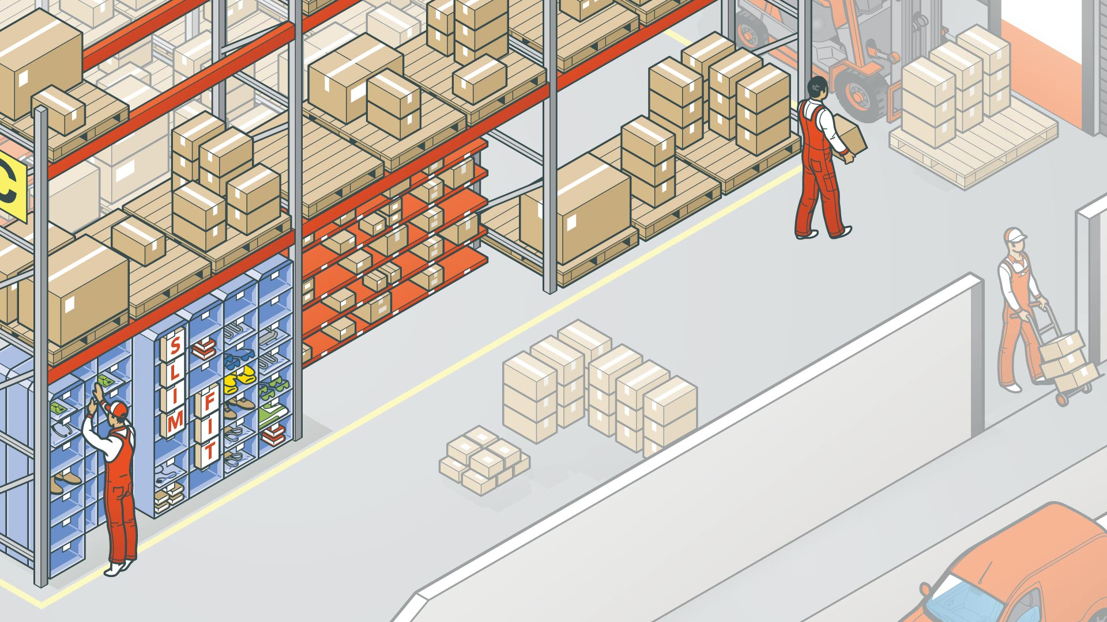
Why Storeganizer?

Slide 10


Slide 11

Innovative, high-density storage system providing a slim fit for all your small slow movers.

Slide 12

+40% usable storage space

Slide 13

Anywhere Any rack
Universal hanging system allows easy installation in any existing rack, where-ever needed in your warehouse.

Slide 14

-26%
travelling times

Slide 15

Optimal picking, less bending/lifting
Stacked up to three rows deep, sliding left/right on rollers for easy access to pockets in the back.

Slide 16
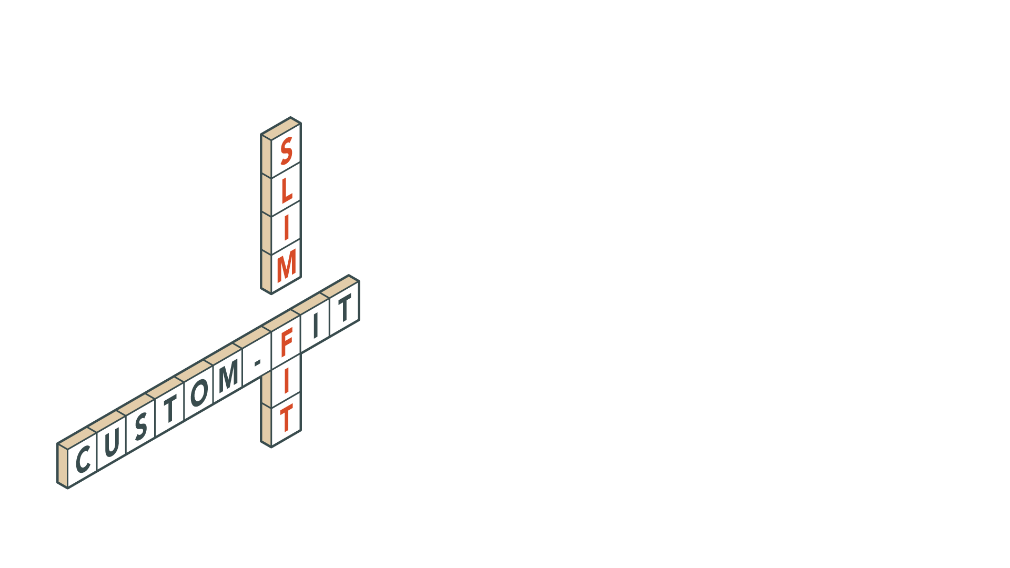
Tailor-made for your inventory needs
Open sizes and specifications – not limited to pre-set standard ranges.

Slide 17

Industrial fabric
cost-efficient, environmentally sound, highly protective.

Slide 18

Storing small items on shelves wastes space
Storeganizer packs them more densely in vertical columns of slim pockets for greater space savings and faster picking.

Slide 19
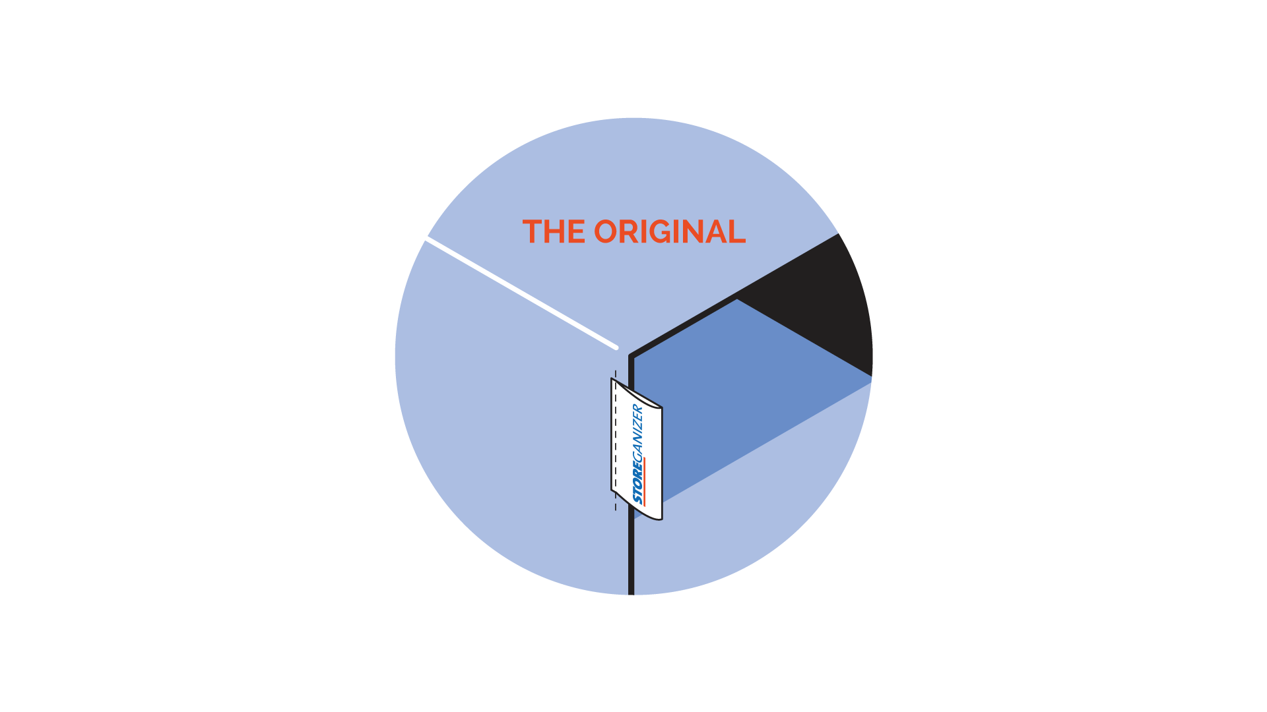

Slide 20
References

Slide 21
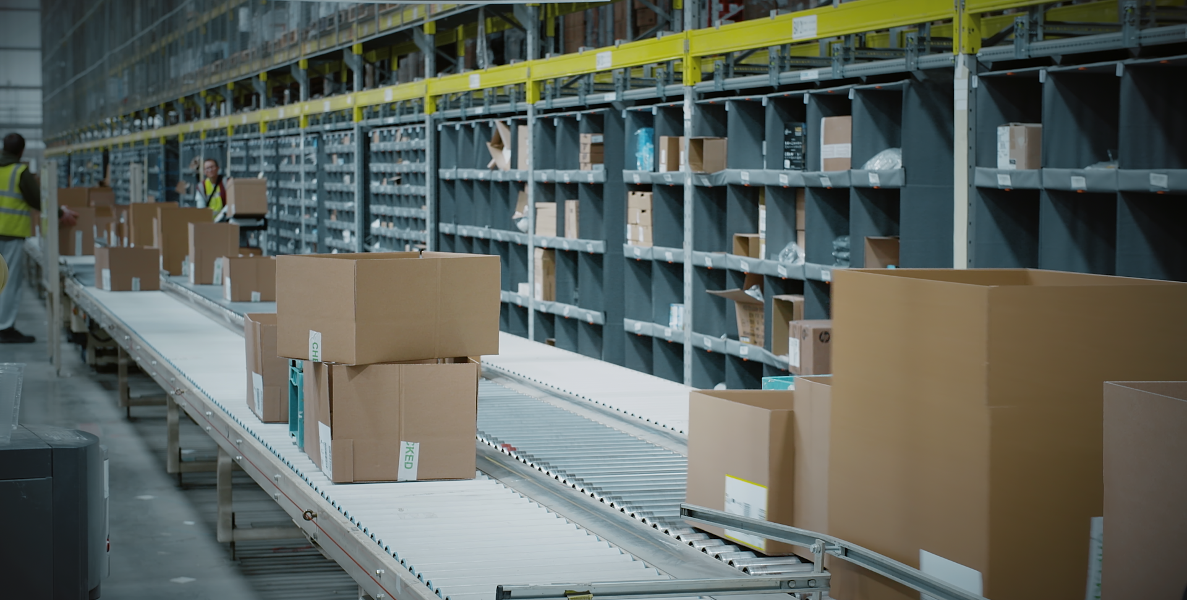
At Ingram Micro picking rate in the Storeganizer section went up by 20 %
“Considering a Storeganizer solution to compete against carousels, flow racking
or even low level mezzanine structures is a worthwhile exercise. You’ll probably find
that you’ll get most of the benefits at a fraction of the cost.”
David Cuddeford Principal Engineer at Ingram Micro

Slide 22
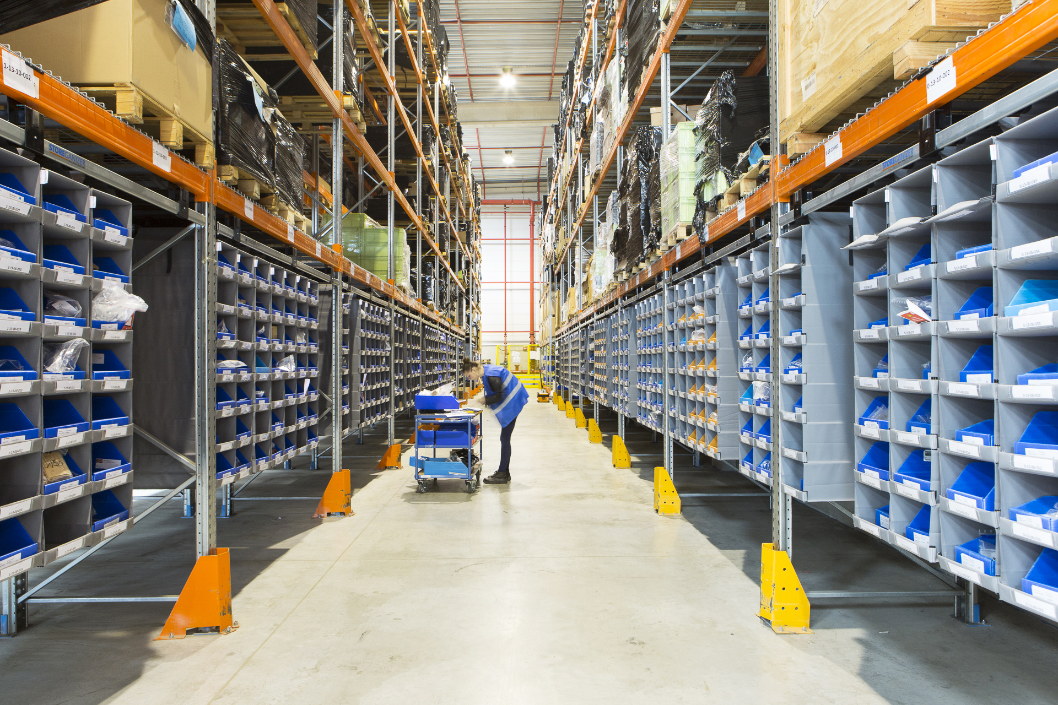
ID Logistics accommodates
additional product line thanks
to Storeganizer
“There is simply no
other solution that
is able to optimise
small SKU storage
to the same extent ”
Jérôme Mellerin
Site Manager at ID Logistics Paris

Slide 23
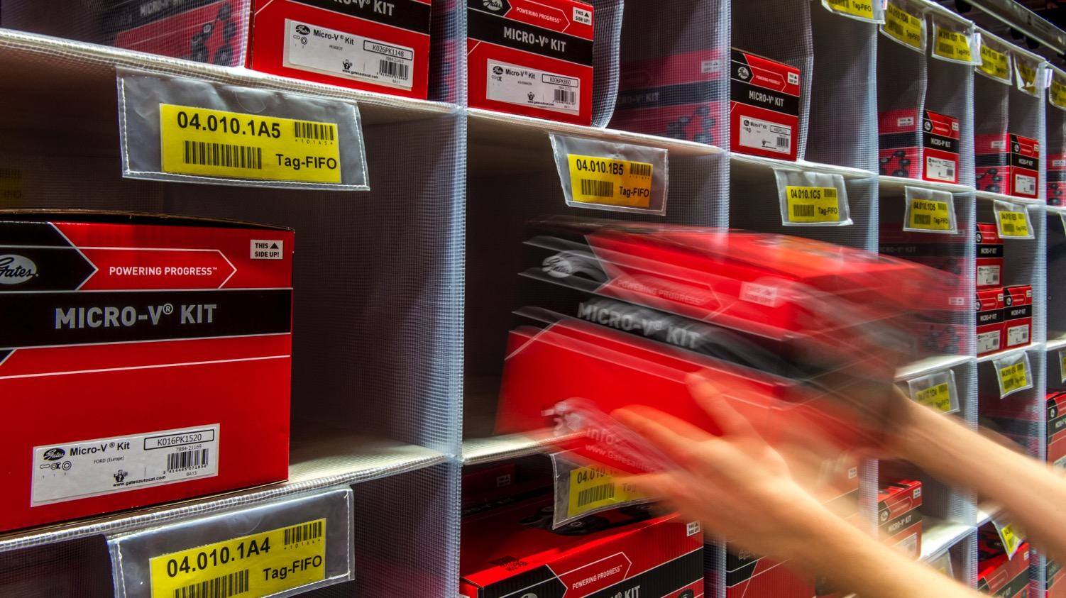

Gates optimizes idle warehouse space with Storeganizer
“Compared with our previous system, we save no less than 90% of the space in square and cubic metres with densely packed Storeganizer columns.”
Hilde De Meyer System Administrator at Gates

Slide 24
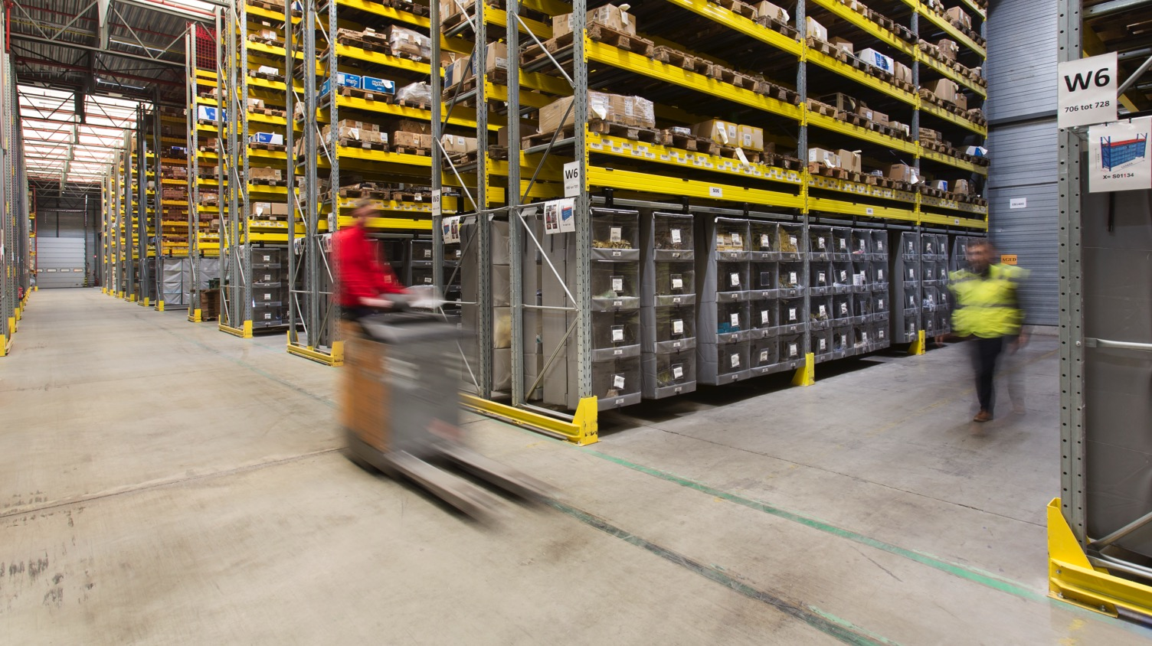
Increased capacity and efficiency at H. Essers thanks to Storeganizer
“I had no clue that such an efficient system to create supplementary stock room existed, offering a fitting degree of flexibility as well. We were able to continue our business operations as usual, our employees did not need to make any adaptations. Everyone is very pleased about it.”
Carlo Theunissen Business Unit Manager at H.Essers

Slide 25
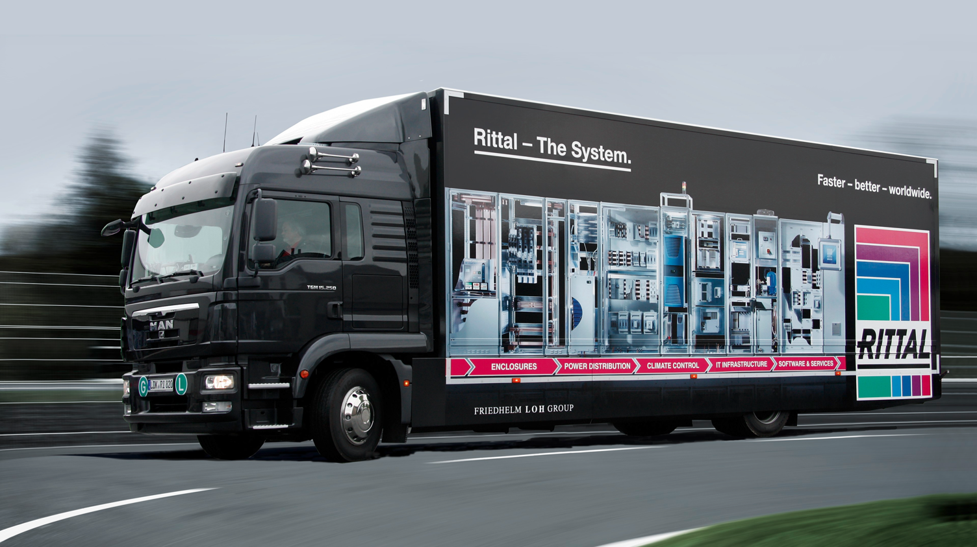
Teeming warehouse achieves 80% space savings with Storeganizer
“Rarely do you achieve a
‘win-win’ with new products. In this case, there are no disadvantages. These columns increase efficiency, eliminate expensive rack upgrades, site expansion or offsite leases, improve tidiness, lower staff stress and impress corporate leadership. We only wish we had discovered it earlier.”
Todd Bayless
Material Services Team Lead at Rittal

Slide 26















Other references

Slide 27
Questions?

